Slide 1
Class – Information hiding (Chapter 5)
Information hiding
Encapsulation

Slide 2
Information Hiding
Programmer using a class method need not know details of implementation
    Only needs to know what the method does
Information hiding:
    Designing a method so it can be used without knowing details
Also referred to as abstraction
Method design should separate what from how

Slide 3
Pre- and Post-condition Comments
Pre-condition comment
    States conditions that must be true before method is invoked
Example

Slide 4
Pre- and Post-condition Comments
Post-condition comment
    Tells what will be true after method executed
Example

Slide 5
The public and private Modifiers
Type specified as public
    Any other class can directly access that object by name
Classes generally specified as public
Instance variables usually not public
    Instead specify as private

Slide 6
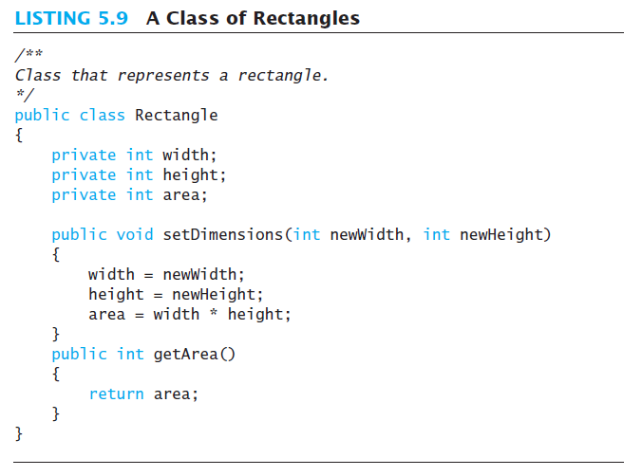

Slide 7
Programming Example
box.width = 6;
is illegal since width is private
setDimensions method
  This is the only way the width and height may be altered outside the class

Slide 8
Accessor and Mutator Methods
When instance variables are private must provide methods to access values stored there
    Typically named getSomeValue
    Referred to as an accessor method
Must also provide methods to change the values of the private instance variable
    Typically named setSomeValue
    Referred to as a mutator method

Slide 9
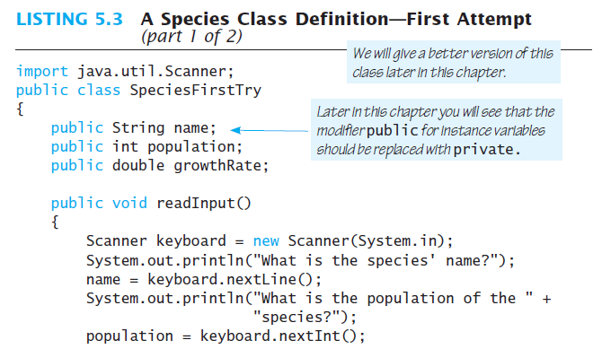
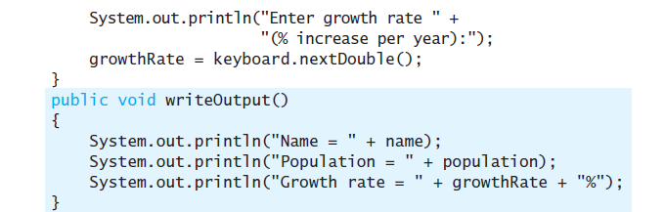
Exercise – code example

Slide 10
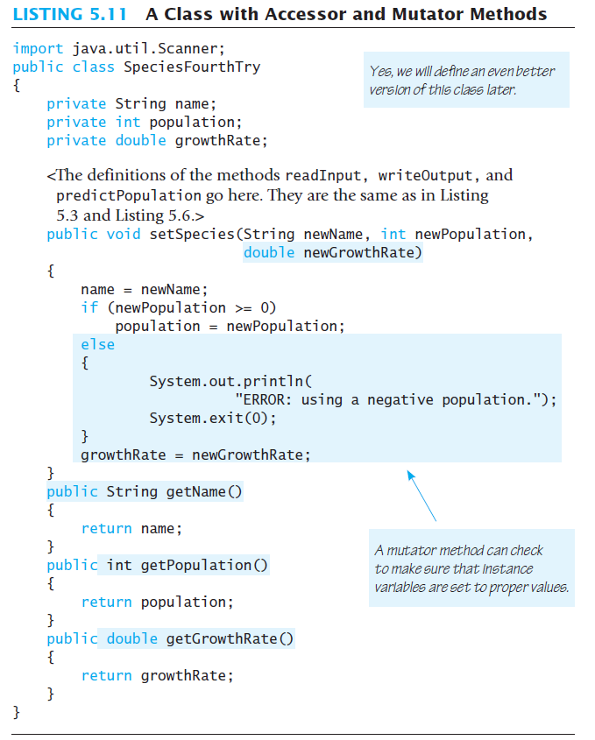
Code example

Slide 11
Accessor and Mutator Methods
Mutator method
    setSpecies
Accessor methods
    getName, getPopulation, getGrowthRate

Slide 12
Methods Calling Methods
A method body may call any other method
If the invoked method is within the same class
    Need not use prefix of receiving object
    public class oracle {
    public void chat()
    {
    answer();
    }
    private void answer() {
    }
    }

Slide 13
Encapsulation
Consider example of driving a car
    We see and use break pedal, accelerator pedal, steering wheel – know what they do
    We do not see mechanical details of how they do their jobs
Encapsulation divides class definition into
    Class interface
    Class implementation

Slide 14
Encapsulation
A class interface
    Tells what the class does
    Gives headings for public methods and comments about them
A class implementation
    Contains private variables
    Includes definitions of public and private methods

Slide 15
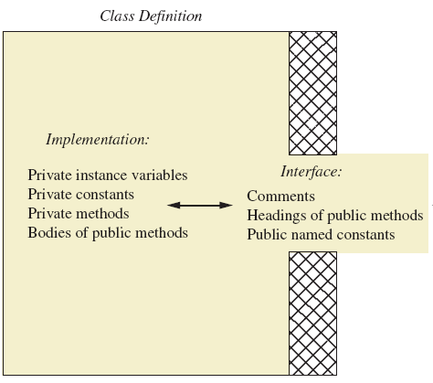
Encapsulation
A well encapsulated class definition
Programmer who uses the class

Slide 16
Encapsulation
Preface class definition with comment on how to use class
Declare all instance variables in the class as private.
Provide public accessor methods to retrieve data
Provide public methods manipulating data
    Such methods could include public mutator methods.
Place a comment before each public method heading that fully specifies how to use method.
Make any helping methods private.
Write comments within class definition to describe implementation details.

Slide 17
Objects and References: Outline
Variables of a Class Type
Defining an equals Method for a Class
Boolean-Valued Methods
Parameters of a Class Type

Slide 18
Variables of a Class Type
All variables are implemented as a memory location
Data of primitive type stored in the memory location assigned to the variable
Variable of class type contains memory address of object named by the variable

Slide 19
Variables of a Class Type
Object itself not stored in the variable
    Stored elsewhere in memory
    Variable contains address of where it is stored
Address called the reference to the variable
A reference type variable holds references (memory addresses)
    This makes memory management of class types more efficient

Slide 20
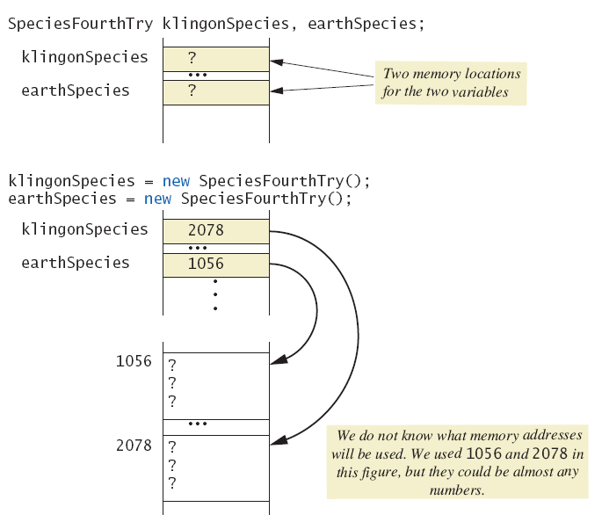
Variables of a Class Type
Behavior of class variables

Slide 21
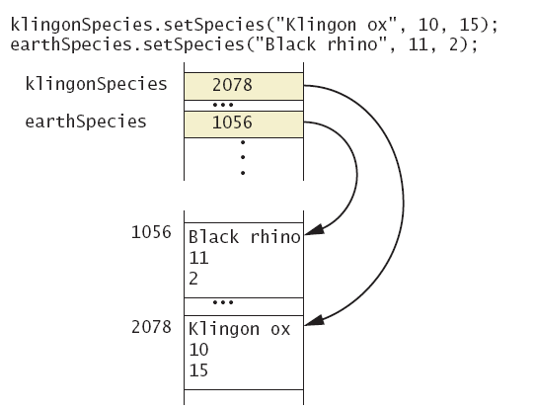
Variables of a Class Type
Behavior of class variables

Slide 22
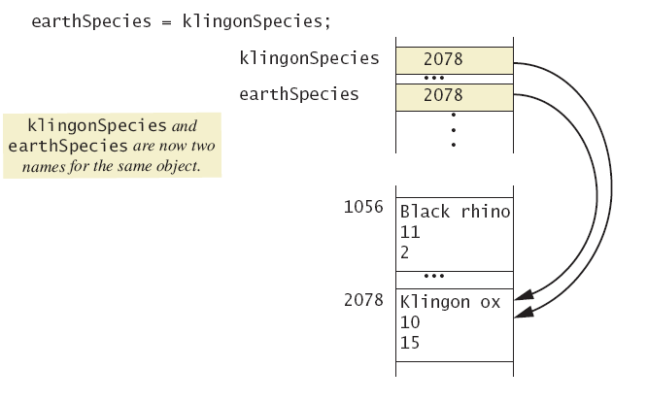
Variables of a Class Type
Behavior of class variables

Slide 23
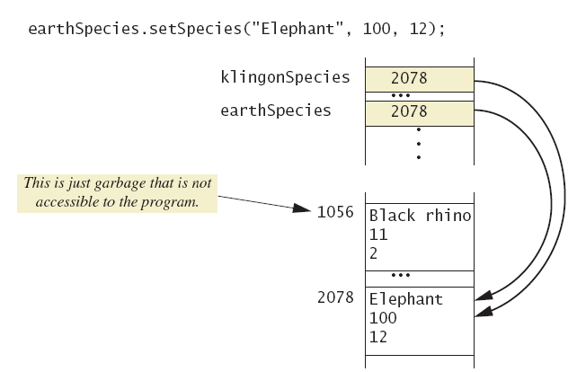
Variables of a Class Type
Behavior of class variables

Slide 24
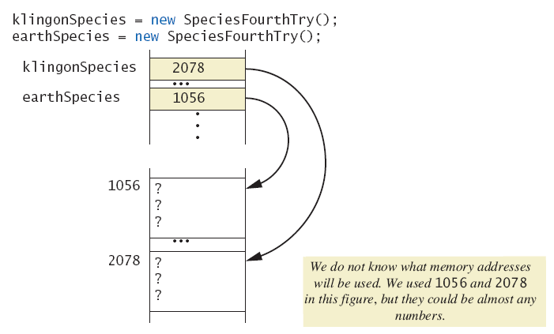
Variables of a Class Type
Dangers of using == with objects

Slide 25
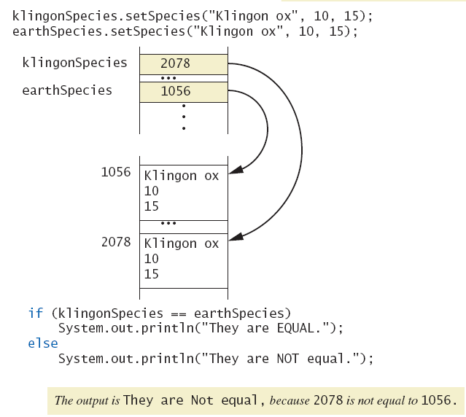
Variables of a Class Type
Dangers of using == with objects

Slide 26
Defining an equals Method
As demonstrated by previous figures
    We cannot use == to compare two objects
    We must write a method for a given class which will make the comparison as needed
The equals for this class method used same way as equals method for String

Slide 27
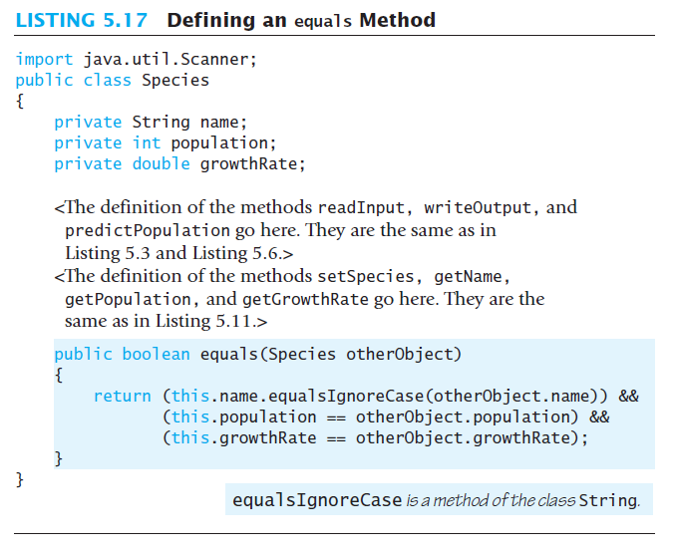
Demonstrating an equals Method

Slide 28
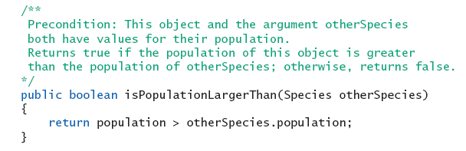
Boolean-Valued Methods
Methods can return a value of type boolean
Use a boolean value in the return statement

Slide 29
Parameters of a Class Type
When assignment operator used with objects of class type
    Only memory address is copied
Similar to use of parameter of class type
    Memory address of actual parameter passed to formal parameter
    Formal parameter may access public elements of the class
    Actual parameter thus can be changed by class methods

